Slide 1
Checking and securing understanding of plotting coordinates with technology
Task A: Plotting sequences and rules using technology
1) Use the table function in Desmos to generate the first ten terms of the arithmetic sequence 20 − 4n Once plotted resize your axes so that all ten terms are visible.
2) Use the table function to generate the first ten terms of the arithmetic sequence 2.65n − 17.5
Use your graphical representation to identify the first positive term.
3) Use Desmos to explore if the sequences 5n − 40 and 56 − 3n share a common term.

Slide 2
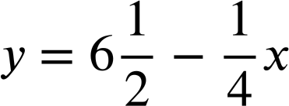
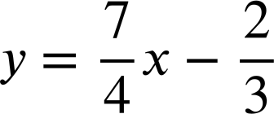
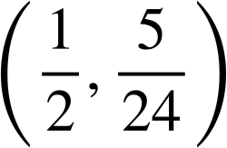
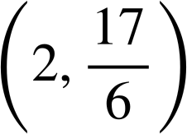
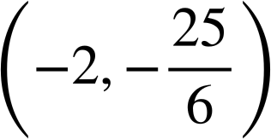
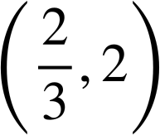
Checking and securing understanding of plotting coordinates with technology
4) Use Desmos to graphically represent the rules and y = 3.26x + 18.7
Identify the quadrant in which they intersect.
Task B: Identifying if points fit a rule
1) Use Desmos to find which coordinate does not fit the same rule as the others.
(−5, 23)
(1, 5)
(−1,−11)
(0, 8)
(4, 4)
(−3, 17)
(6,−10)
2) Which coordinates fit the rule ?

Slide 3
Checking and securing understanding of plotting coordinates with technology
3) Use Desmos to graphically represent the rules
y = 3x − 13 and y = 17 − 2x
Identify which of these three coordinates fits both rules.
(5, 7)
(6, 5)
(7, 8)
Mathematics in Education and Industry
v2.2

